Slide 1

Gene Network Models for Cellular Aging
Hong Qin
July 29, 2011

Slide 2
Outline
Introduction on cellular aging A reliability model of cellular aging based on stochastic gene networks Experimental tests of the reliability model A nonproliferation model of cellular aging based on G1/S check point.

Slide 3
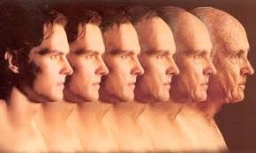
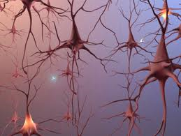
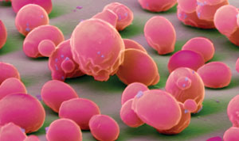
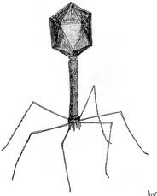
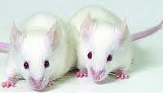
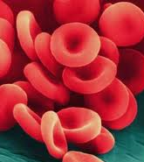
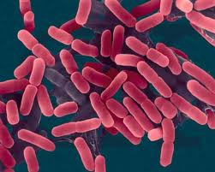
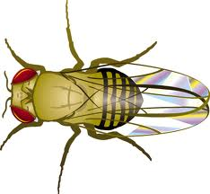
Aging is a fundamental question in biology, yet its mechanism remains elusive.

Slide 4
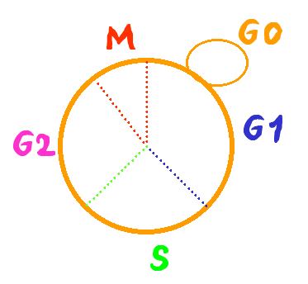
The life span of the budding yeast S. cerevisiae
Replicative life span
The average number of offsprings of single mother cells
dividing cells
Chronological life span
The duration of cells in stationary phase
non-dividing cells
Notes:
As a cellular organism, the life span of yeast can be measured in two different ways. The RLS and the CLS.
How to assay RLS?
S. cerevisize grow by budding out new cells. The new cells are smaller than the old mother cells. This enable us to identify the mother and daughter cells under microscope and separate them by by micro dissection.

Slide 5
Assay of replicative life span in yeast
new bud
remove bud with micro-manipulator
90 min @ 30 ˚C
repeat until cells no longer reproduce

Slide 6
Assay of chronological life span in yeast
t=0
t=1day
t=5 days

Slide 7
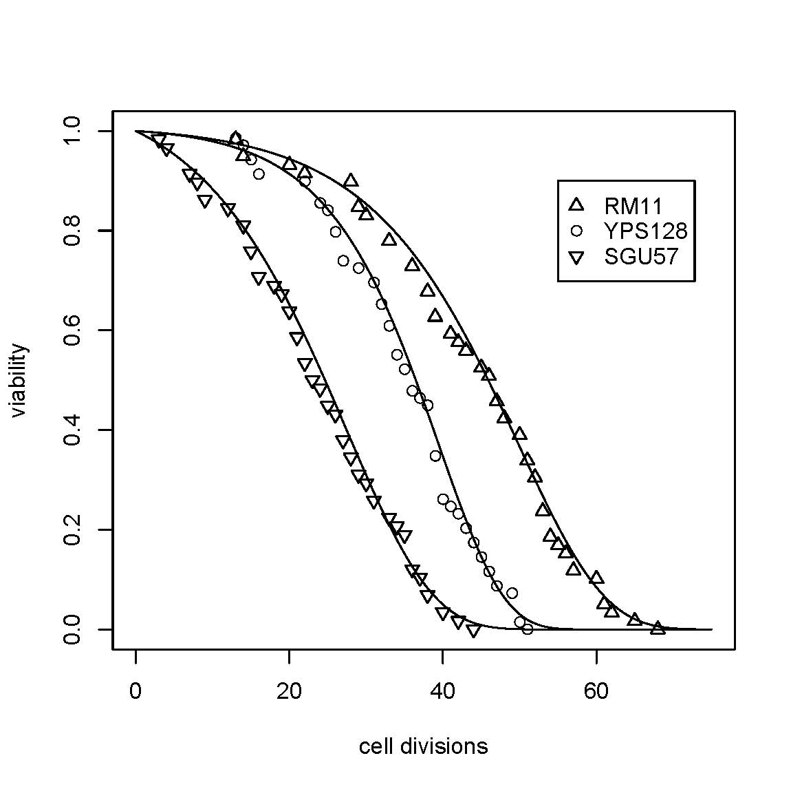
Replicative life spans of yeast isolates
Qin and Lu, 06
Exp Gerontology
Notes:
Regression of avg with group + strain

Slide 8
Gompertz model of aging (A descriptive model)
Aging is modeled as exponential increase of mortality rate over time.
R₀ : initial mortality rate, innate susceptibility to dying, lifespan potential at birth.
G: an coefficient for mortality rate acceleration (rate of aging)
Notes:
Gompertz mortality model (constant hazard model)
Mortality Rate: m = - (ds/dt)(1/s) = I₀ e^{Gt}
Viability: s = exp[ (I₀ /G) ( 1 - e^{Gt}) ]

Slide 9
A working definition of (cellular) aging.
Gompertz model

Slide 10
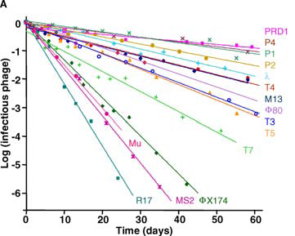
Non-aging systems
De Paepe & Taddei, 2006, Plos Biology

Slide 11
A paradox in yeast aging
Genes with known effect on life span show no molecular mechanisms that are directly linked to aging.
SIR2
How does ERC affect aging?
TOR1/2
?
Sch9
?
Notes:
Longo’s sir2 role cell paper: sir2D sch9D -> extremely long cls (However, Fig1D shows that sir2D actually has larger variance, median seems to be similar to WT in haploid background.)

Slide 12
It seems that once we delve into the molecular mechanism of aging, we lose the biology of aging. Why?

Slide 13
Another paradox in yeast aging
There exist universal demographic characteristics of aging despite the diverse genetic and environmental factors involved.
This universality suggests a common random process.

Slide 14
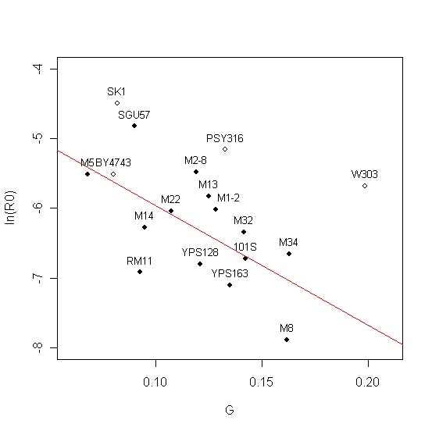
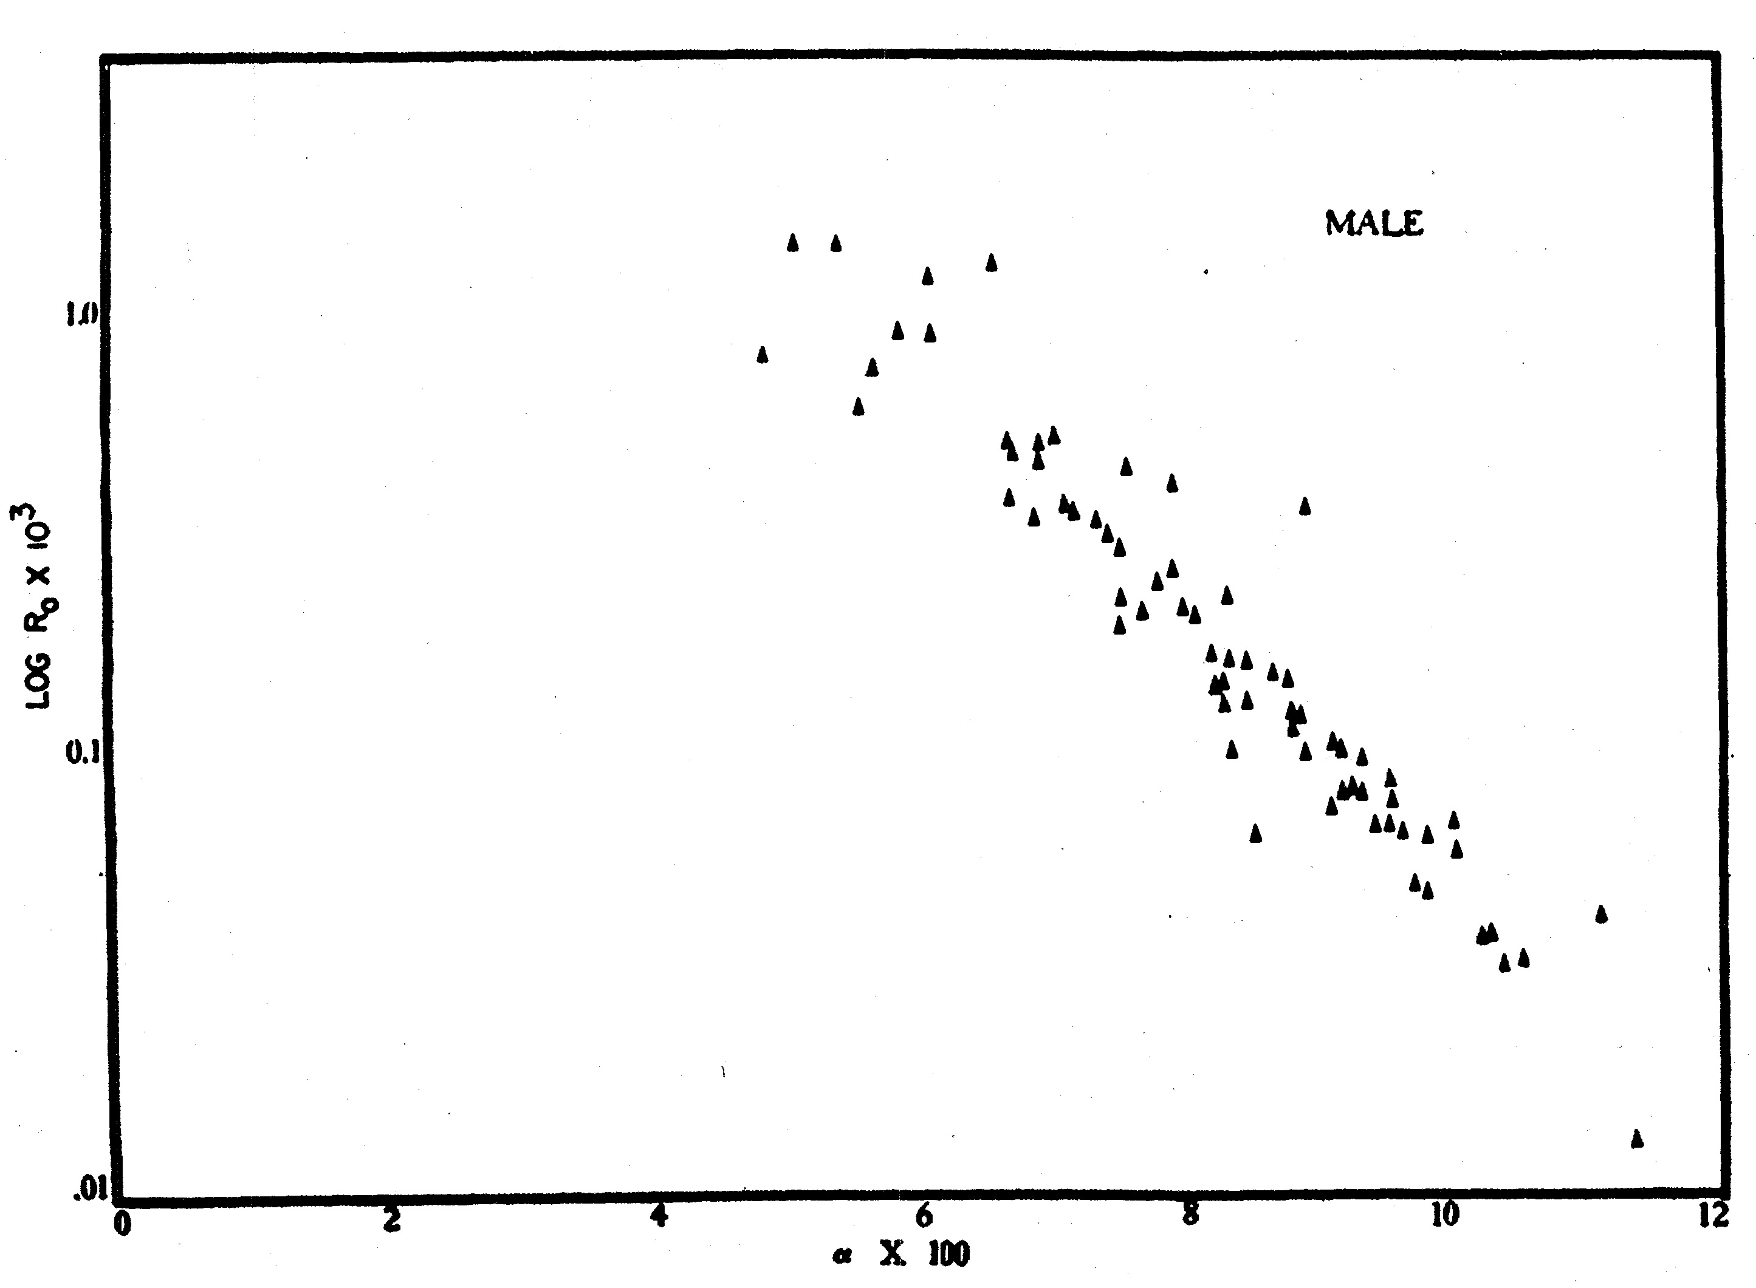
Yeast aging is similar to mammalian aging at the demographic level.
Yeast
Human
Ln(R0)
G
Qin & Lu, 2006 Exp Gerontology
Strehler & Mildvan, 1960 Science
Notes:
Regression is only done to the natural isolates (solid black dots).

Slide 15
Yeast aging is a stochastic process to a large extent.
Model 1: AGE_{ijk} ~ u + STRAIN_{i} + GROUP_{j} + PLATE_{ij} + e_{ijk}
Model 2: AGE_{ijk} ~ u + STRAIN_{i} +ζ_{j} + e_{ijk}
Model 3: AGE_{ijk} ~ u + STRAIN_{i} + e_{ijk}
Conclusion: Genotypic variation accounts for 22% of
RLS variation among individual cells.
Qin and Lu, 06
Exp Gerontology
Qin and Lu, 2006

Slide 16
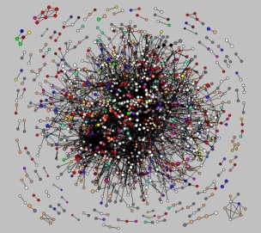
A general theoretic framework for cellular aging
Cellular aging is an emergent property of gene/protein networks

Slide 17
Outline
Introduction on cellular aging A reliability model of cellular aging based on stochastic gene networks Experimental tests of the reliability model A nonproliferation model of cellular aging based on G1/S check point.

Slide 18
A general theoretic framework for cellular aging
Cellular aging is an emergent property of gene/protein networks

Slide 19
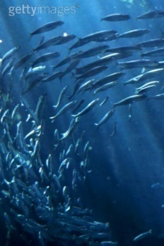

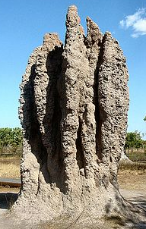
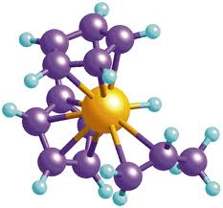
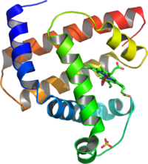
What is an emergent property?
Often loosely refers to the property arising at higher levels as a result of interaction at a low level.
A still debatable concept.
Many examples
Notes:
http://en.wikipedia.org/wiki/Emergent_property
Termite castle
Shoal of fishes

Slide 20
The reliability theory of aging
Aging systems (Machines):
Age-dependent increase of risk to die
Non-aging systems (Radioactive isotopes) :
Age-independent increase of risk to die
Parallel connection of non-aging components can lead to aging systems.
Gavrilov & Gavrilova, 2001 JTB

Slide 21
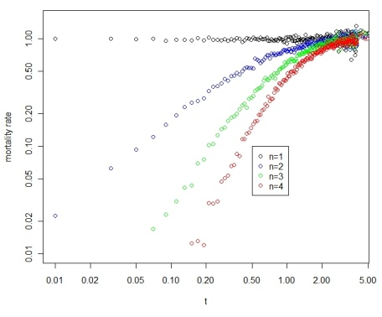
Aging can arise from systems with non-aging components
In essence, characteristics of aging of a system can arise from interactions of non-aging components, i.e., aging is an emergent property.
Notes:
Fig 1. Increase of mortality rate over time, a characteristic of aging, can arise in systems with parallel non-aging components. (A) A system with 4 parallel components (n=4). (B) Simulation of parallel systems with 1,2,3, and 4 non-aging components (constant aging rates).

Slide 22
A gene/protein network model of cellular aging
An essential gene
with four connections
A reliability model
with four parallel pathways

Slide 23
Network with modules
Weibull model of Machine Aging
A network with two
essential modules
Assumption: Links between
modules do not affect aging.
A reliability model
with two modules

Slide 24
Biological aging versus Machine Aging
Machine Aging
Biological Aging
where m(t) is the mortality rate, s is viability, and t is time. C1, C2, R₀, G are constants. Mortality rate increase as a power function in machine aging versus a exponential function in biological aging .
(Garilov & Gavilova 2001)

Slide 25
Modular network with stochastic links
Cell-1
Rationale for stochastic links
Cellular process is a dynamic process
Limited number of protein molecules and the stereo-hindrance effect.
Spatial restrictions
Random choices
Cell-2
Cell-3

Slide 26
Modular network with stochastic links
Gompertz Aging, i.e. Biological Aging
?
?
?
?
Modular network with
stochastic links
?
?
?
?
?
?
A reliability model
with defects
?
?
?
?
?
?
m: the number of modules
n: the number of links per essential gene (essential module)
k: exponential decay rate (constant aging rate)
q: the chance of a link to be functional ( q = avg func links/ n)
c: a normalization constant

Slide 27
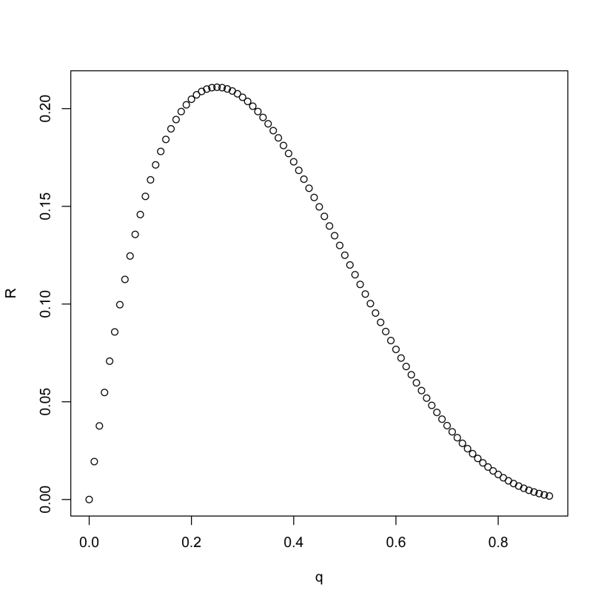
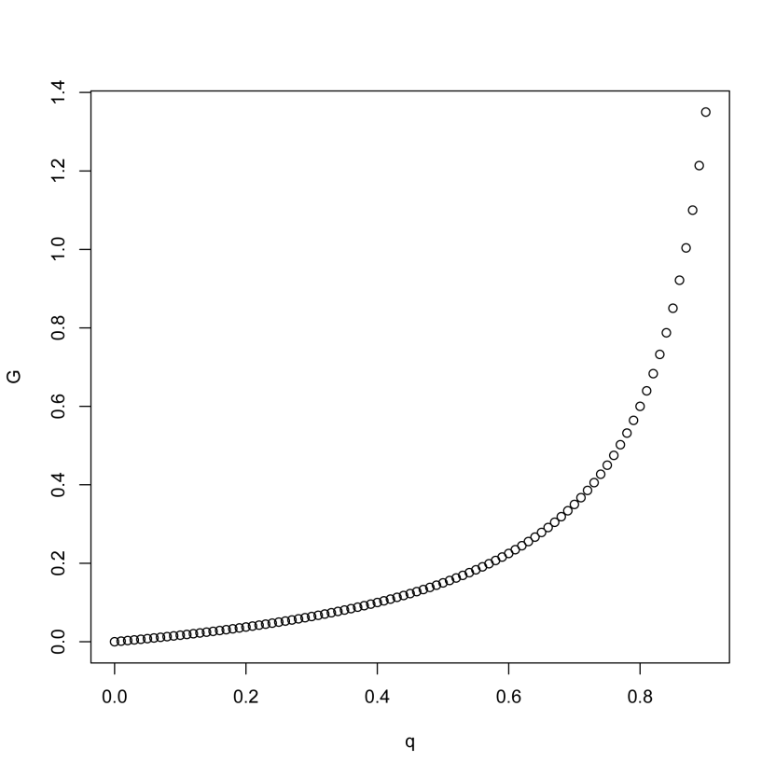
Robustness on R₀ and G
Notes:
For my Tg/C results, R0 is negatively correlated. But G is not significantly correlated in partial regression. I need more data. So Kaberlein’s data is really a geneous gift to me. I can measure the oxidative tolerance of these strains, or mutational tolerance Tg/Tc of these strains.

Slide 28
Some implications of cellular aging as an emergent property of networks.
Trade off between R0 and G (negative correlation between lnR0 and G).
There is no real “aging” genes.
Ageing is influenced but not controlled by genes, Kirkwood &Finch 2002, Nature.
We should pay more attention to gene interactions and their temporal dynamics.
Can a gene’s effect on the Gompertzian parameters be predicted by its network-related features?
Number of links of essential modules → rate of aging ?
Genes with overall effect on network → initial mortality rate.
Notes:
How about SIR2, shc9, ros1, hxk, fob1?
Laboratory strain BY4743 show smaller Gompertz coefficient than wild isolates, especially for CLS.

Slide 29
Implications of the network aging model
Theoretic perspectives
Power-law networks versus random networks
Connection between aging and genetic capacitors
Heterogeneous rates of exponential decays
Empirical perspectives
G as a proxy of robustness (a phenotypic measure).
Provides a new perspective to interpret experimental data.
Provides a different perspective on interpreting GWA on life-history traits.

Slide 30
Antagonistic pleiotropy theory of aging
Network-based models will put pleiotropy model on a mechanistic foundation.
Williams 1957
Trade-off
Early benefits and late costs
Pleiotropy
Gene interactions
Influenced by network temporal dynamics

Slide 31
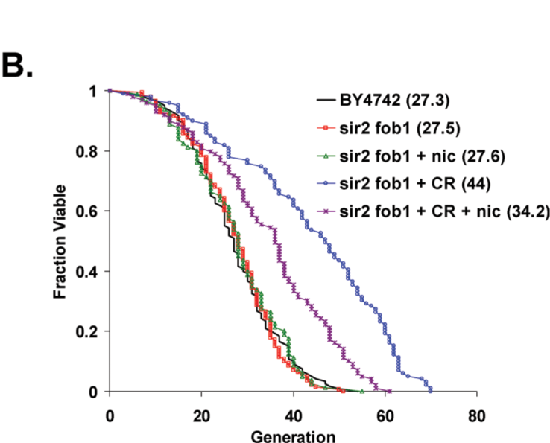
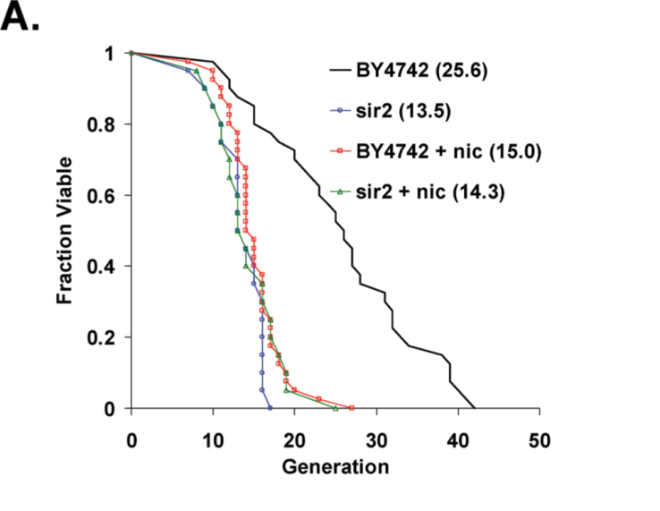
SIR2 effect on G and R0: an effect on q? .
Kaeberlein et al 2006, PlosGenetics
Notes:
Verify by GFP, stochasticty in sir2D mutants?

Slide 32
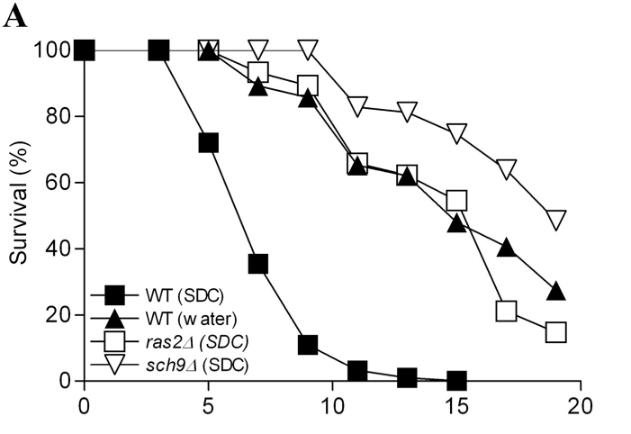
Sch9 seems to influence the Gompertz coefficient.
Fabrizio et al 2004, JBC

Slide 33
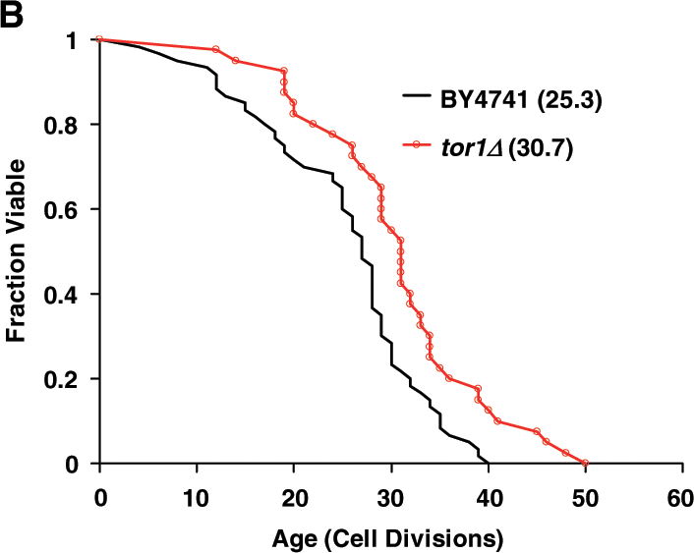
TOR1 seems to influence the initial mortality rate.
Kaeberlein et al, 2005 Science

Slide 34
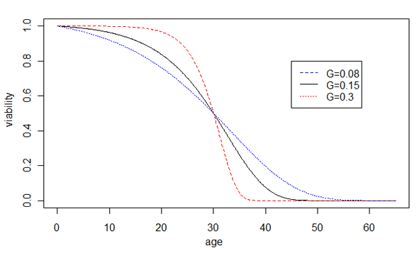
Prediction of the network model of cellular aging
Increased robustness
Decreased robustness
Notes:
Prediction of our hypothesis, the effect of network robustness on the rate of aging G, is shown by changes of the Gompertz survival curves. Increased robustness leads to larger G and faster aging, shown by the sharper transition of the dying off phase, whereas decreased robustness leads to smaller G and slower aging, shown by the slower dying off phase. For illustration purposes, the average life spans are unchanged.

Slide 35
Outline
Introduction on cellular aging A reliability model of cellular aging based on stochastic gene networks Experimental tests of the reliability model A nonproliferation model of cellular aging based on G1/S check point.

Slide 36
Testing the model: Diploid cells age faster than haploid cells
Table Aging rate is faster in diploid BY4743 than in haploid strains based on nest model tests.
Models | lnL
H0 R_{BY4741} = R_{BY4742} = R_{BY4743}, G_{BY4741}= G_{BY4742}= G_{BY4743} | -952.7
H1_{g2} R_{BY4741} = R_{BY4742} = R_{BY4743}, G_{BY4741}= G_{BY4742}≠G_{BY4743} | -946.1
H1_{i2} R_{BY4741} = R_{BY4742} ≠R_{BY4743}, G_{BY4741}= G_{BY4742} = G_{BY4743} | -939.4
H2_{ig2} R_{BY4741} = R_{BY4742} ≠ R_{BY4743}, G_{BY4741}= G_{BY4742}≠G_{BY4743} | -937.2
H3_{i3ig2} R_{BY4741}≠ R_{BY4742}≠ R_{BY4743}, G_{BY4741}= G_{BY4742}≠G_{BY4743} | -929.3 | Best parsimonious model p-value=3.6x10⁻¹⁰ (chi-square, df=3) G_{BY4741}= G_{BY4742} = 0.0653 G_{BY4743} = 0.0786
H6 R_{BY4741}≠R_{BY4742}≠R_{BY4743}, G_{BY4741}≠G_{BY4742}≠G_{BY4743} | -929.3

Slide 37
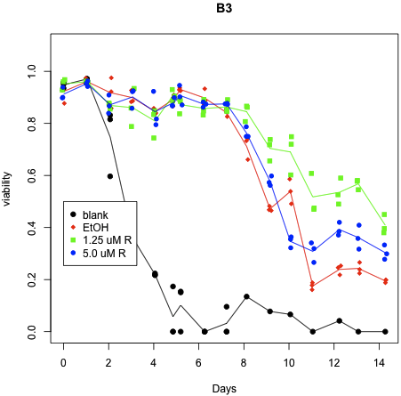
Testing the model: The effect of radicicol on chronological aging
P-value = 0.027
Increased robustness
Decreased robustness

Slide 38
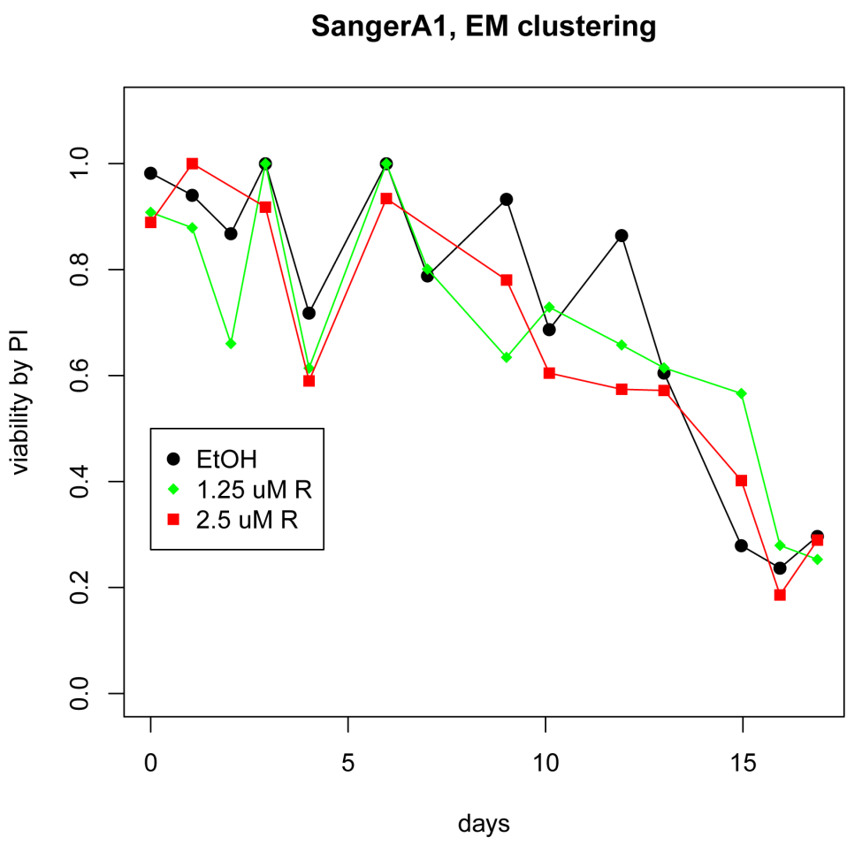
Effect of radicicol on chronological aging (cont’d)
Increased robustness
Decreased robustness

Slide 39
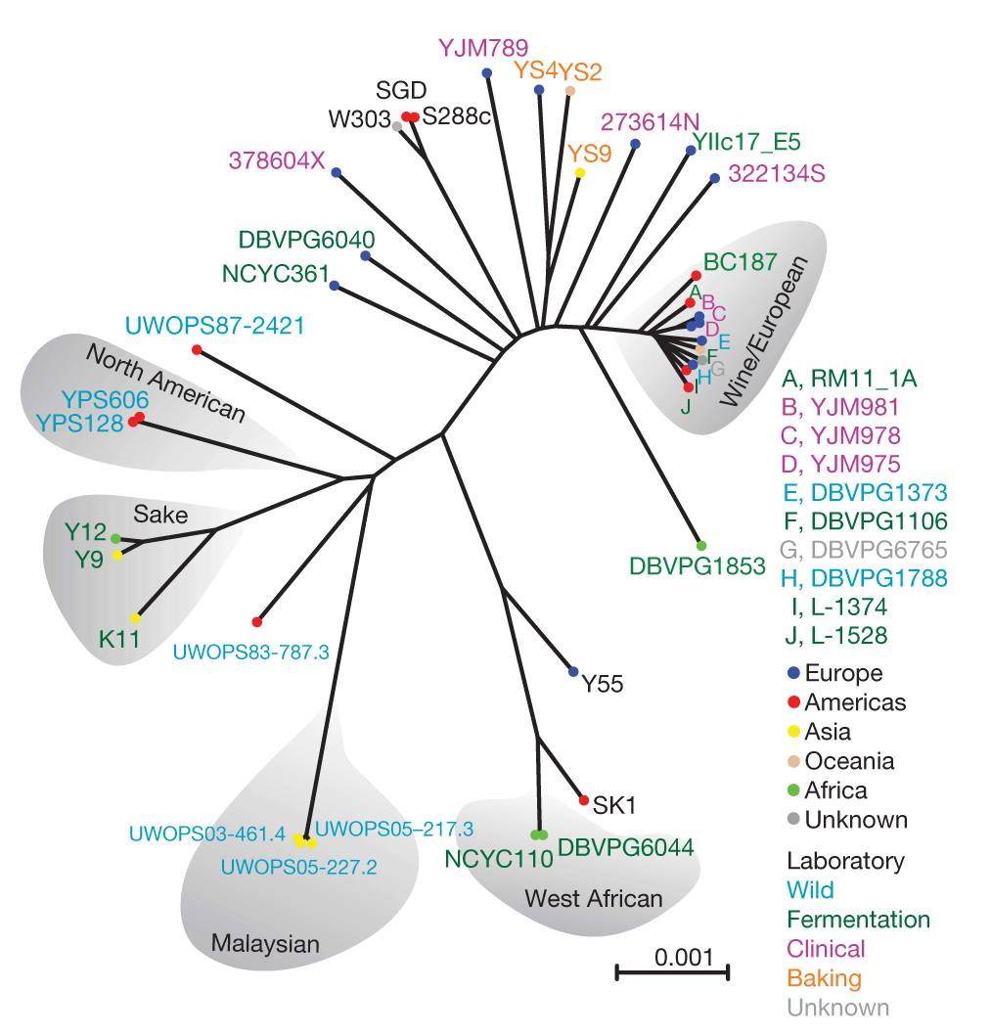
Search for loci associated with lifespan in sequenced strains.
Liti et al 2009 Nature

Slide 40
Preliminary results of GWAS on CLS
Sequenced Sanger Strains
(200K SNPs)
Focus on chr01 & 02
Look for SNP clusters
in 1Kb distance
CLS by PI and Flow Cytometry
Partition strains to short, average, long-lived
68 clusters (>10 SNPS)
Visually check 3 large clusters
Fisher’s exact test
(pop structure is ignored)
ncDNA, FLO9, PRM9, MAL31
37K SNPs with q<=0.1

Slide 41
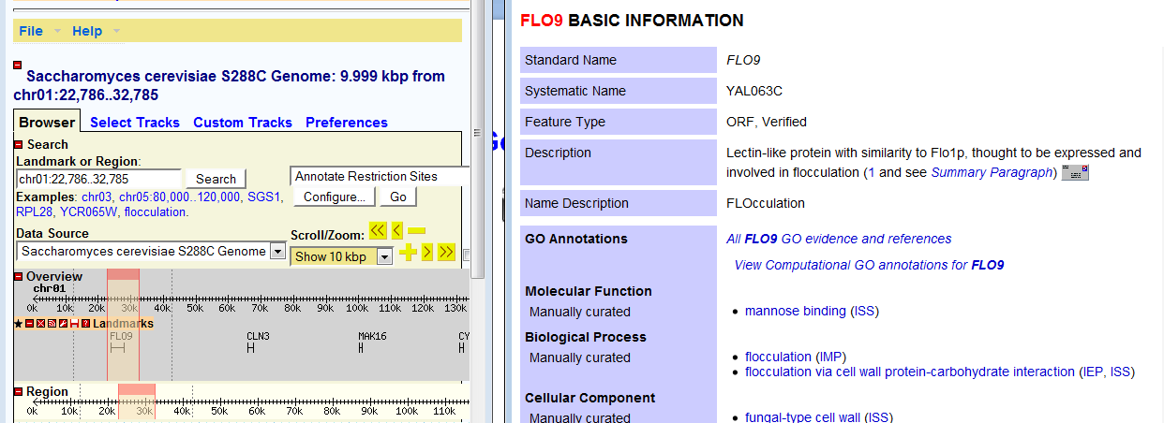
FLO9 and its 5’UTR is a major cluster

Slide 42
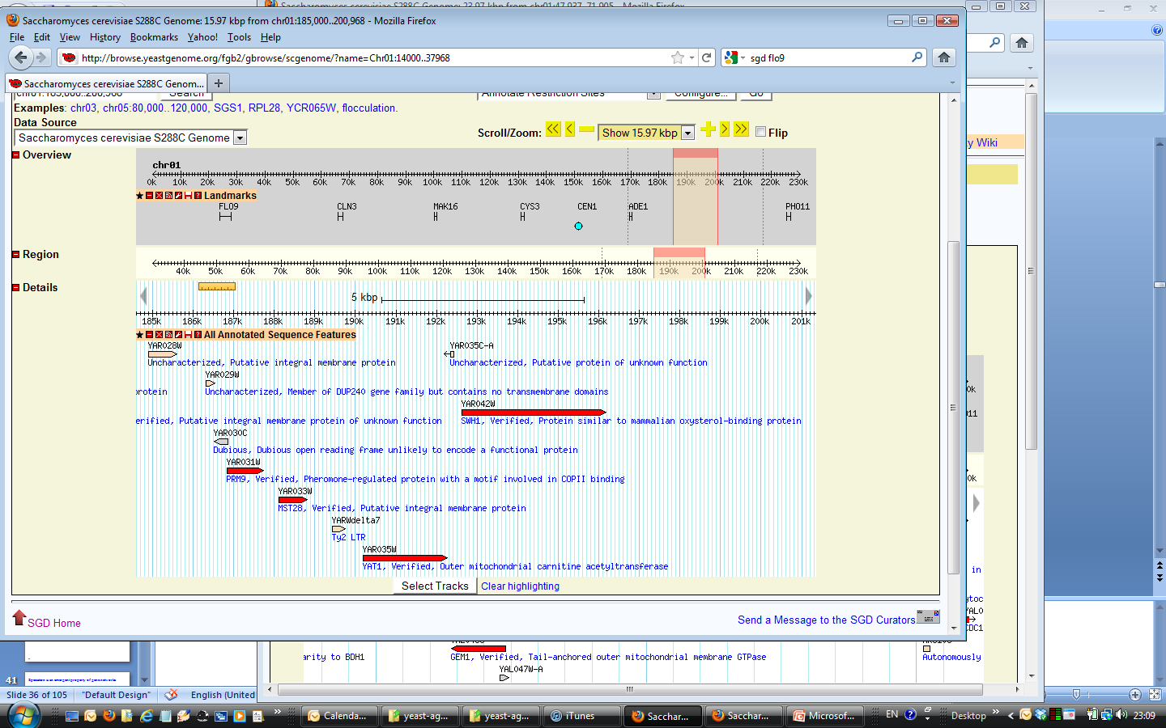
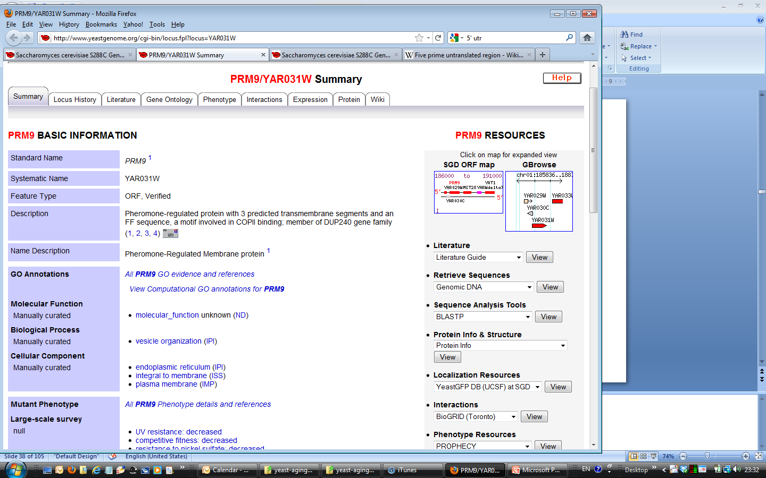
PRM9 and 3’UTR

Slide 43
Outline
Introduction on cellular aging A reliability model of cellular aging based on stochastic gene networks Experimental tests of the reliability model A nonproliferation model of cellular aging based on G1/S check point.

Slide 44
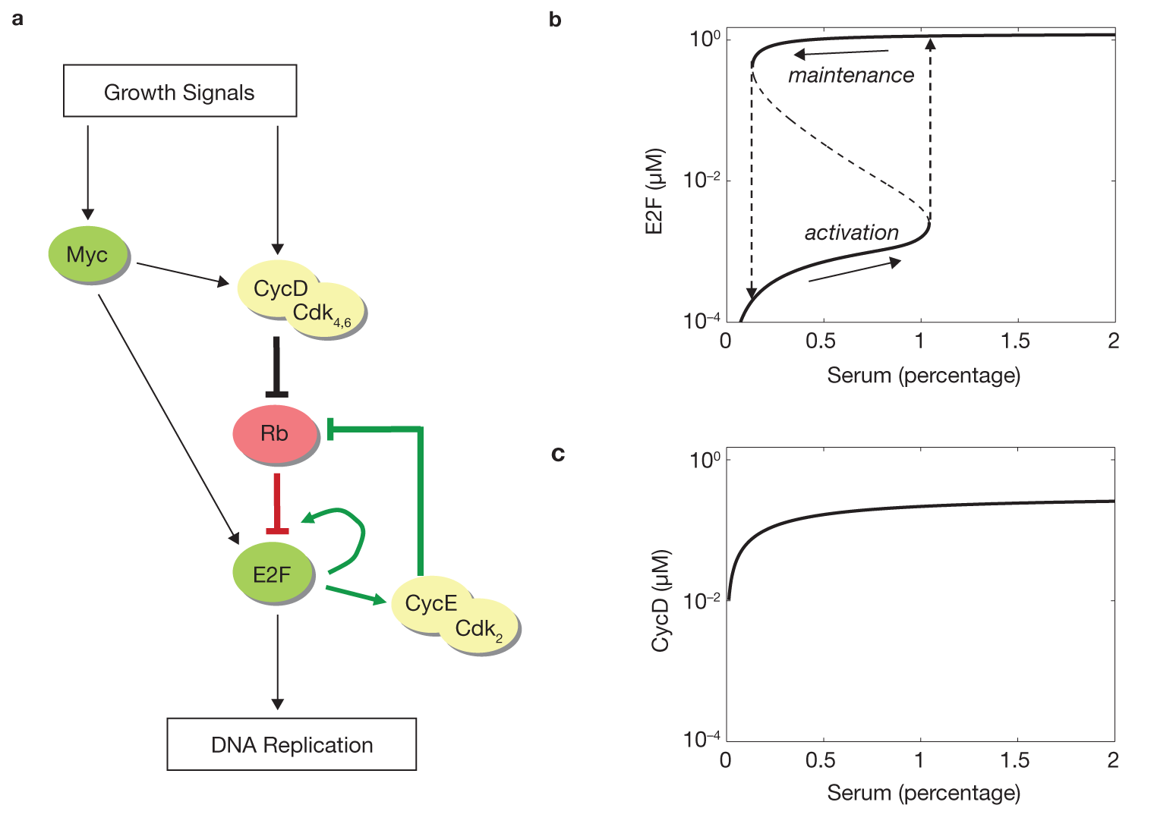
The Rb-E2F bistable switch in G1/S check point
Yao et al , 2008 Nature Cel Biol

Slide 45
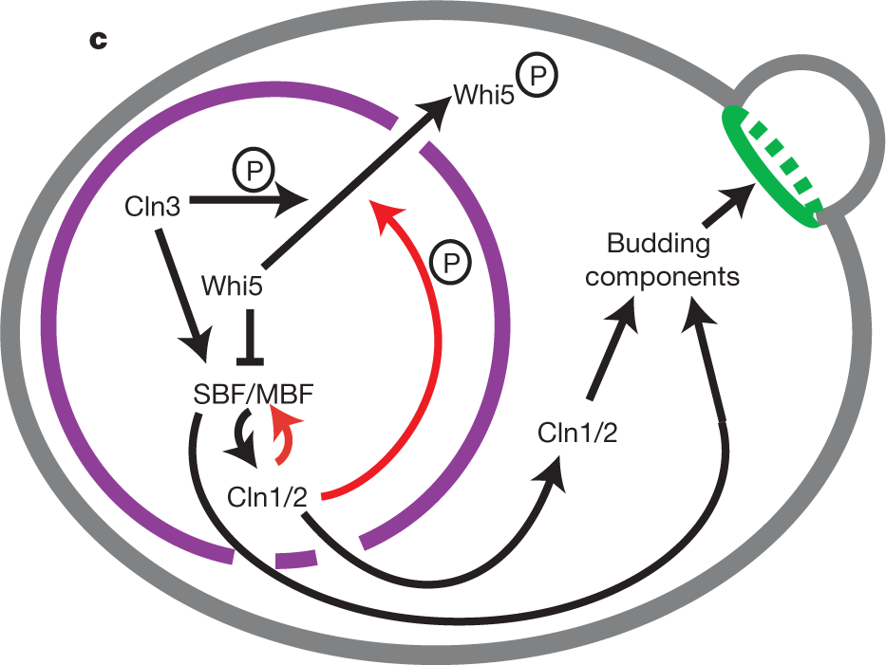
The Rb-E2F switch is conserved in yeast.
CLN3
(CycD)
WHI5
(Rb)
SBF
(E2F)
Growth
Quiescence:
Arrest in the poor growth conditions
Senescence:
Arrest in good growth conditions
Skotheim , 2008 Nature

Slide 46
A non-proliferation model of cellular aging based on G1/S check point.
CLN3
(CycD)
WHI5
(Rb)
SBF
(E2F)
Glucose
H2O2
O2
Senescence: arrest in good growth conditions
Quiescence: arrest in the poor growth conditions
Notes:
WHI5 (Rb) initially should be high to inhibit SBF (Yao 08, Nature Cell Biology). When growth triggers CLN3, CLN3 will quickly phosphorylate whi5 and move it to cytosol.
Aging will slow down nuclear-cytol traffic.
SBF autoregulates itsself through Cln1/2(CycE)

Slide 47
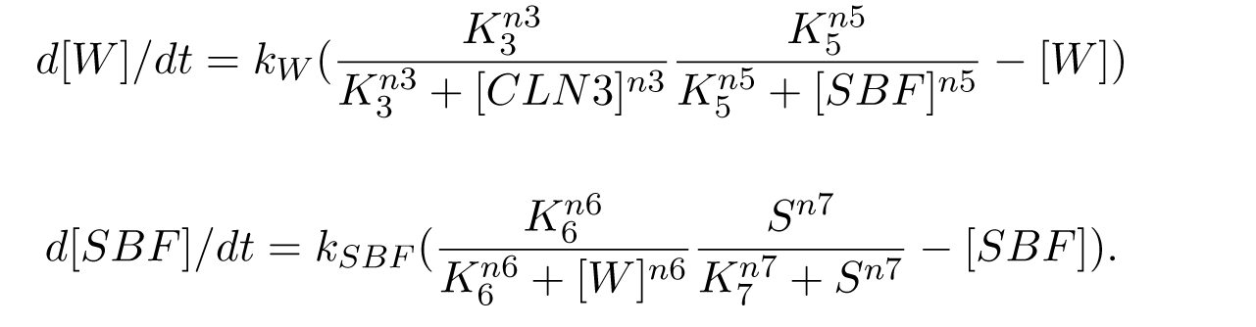
A simple model on G1/S check point.
CLN3
(CycD)
WHI5
(Rb)
SBF
(E2F)
Growth
Notes:
WHI5 (Rb) initially should be high to inhibit SBF (Yao 08, Nature Cell Biology). When growth triggers CLN3, CLN3 will quickly phosphorylate whi5 and move it to cytosol.
Aging will slow down nuclear-cytol traffic.
SBF autoregulates itsself through Cln1/2(CycE)

Slide 48
Uniform sampling of
parameter space and initial conditions
Select parameter sets with bistable [SBF]ss
K5, n5, K6, n6
Bifurcation analysis

Slide 49
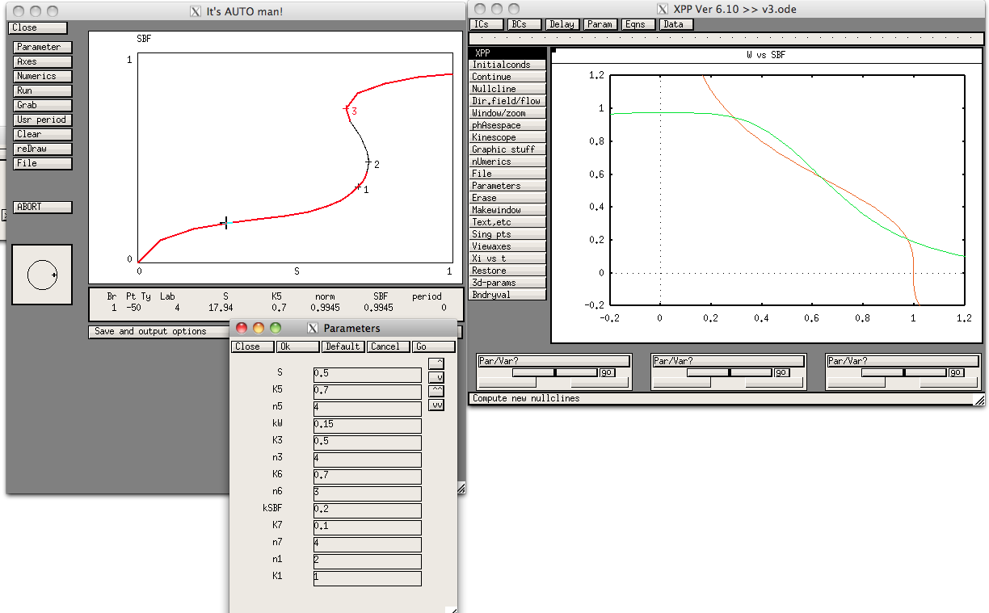
Bifurcation and phase diagrams
stable
unstable

Slide 50
To do: Parameter sensitivity analysis Incorporating nutrient sensing pathways Incorporating aging effect
K7,n7
CLN3
(CycD)
WHI5
(Rb)
K6,n6
SBF
(E2F)
Growth
K3,n3
K5,n5
TORc1
MSN2/4
Aging effect?
Mitochondrion
OTHERS?
Notes:
WHI5 (Rb) initially should be high to inhibit SBF (Yao 08, Nature Cell Biology). When growth triggers CLN3, CLN3 will quickly phosphorylate whi5 and move it to cytosol.
Aging will slow down nuclear-cytol traffic.
SBF autoregulates itsself through Cln1/2(CycE)

Slide 51
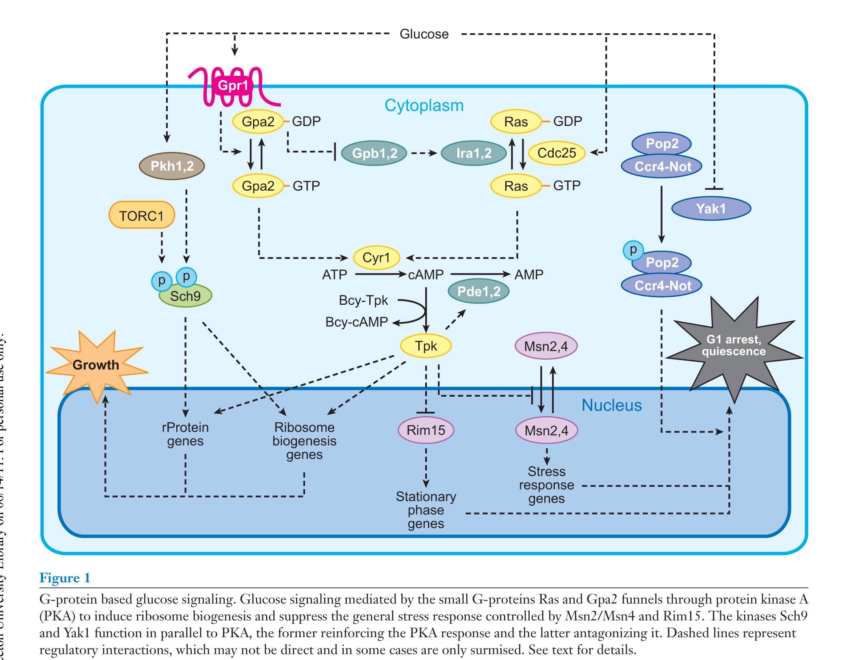
Nutrient sensing and quiescence (Zaman et al, 2008, ARG)

Slide 52









Acknowledgement
David Goldfarb
Meng Lu
François Taddei
Ariel Lindner
Tamara Milosevic
Matt Kaberlein
Brian Kennedy
John Tyson
Chun Chen
Jeffrey Townsend
CSHL CCB course
Shyla Hardwick
Janella Wynter
Erin Jackson
Maxine Linial
Katie Peichel
Suzannah Rutherford
Antonio Bedalov
Dan Gottschling
David Botstein
Alison Gammie
Sandy Silverman
Tina DeCoste

Slide 58
A non-proliferation model of cellular aging based on G1/S check point.
slow
slow
CLN3
(CycD)
slow
WHI5
(Rb)
fast
SBF
(E2F)
Growth
Aging effect on traffic
Notes:
WHI5 (Rb) initially should be high to inhibit SBF (Yao 08, Nature Cell Biology). When growth triggers CLN3, CLN3 will quickly phosphorylate whi5 and move it to cytosol.
When TOR1 is deleted, expression levels on cln3 and cell cycle?
Aging will slow down nuclear-cytol traffic.
SBF autoregulates itsself through Cln1/2(CycE)

Slide 60
Summary
A gene/protein network model of cellular aging ― a general theoretic framework. Cellular aging = network emergent property Aging = emergent property of complexity

Slide 61
Speciation is an emergent property of gene networks.
Population 1
Species 1
Speciation
Gene flow
No Gene flow
Population 2
Species 2
How can we model this?
DM pairs?!

Slide 62
If decay-rate are dependent between genes, it become a multi-loci genetic model (see two-loci model by Nordberg). The effect on QTL

Slide 63
Antibiotic persistence

Slide 64
The fixed point of CLN3 can be found, and the system is reduced to two ODE equations.
Parameters space and initial conditions were uniformed sampled to study the system behaviors. We focused on key parameters (S, Ks) (Coded in R)
Random effect can be introduced by Gillespie method or by Langevian terms.

Slide 66





Thanks

Slide 67
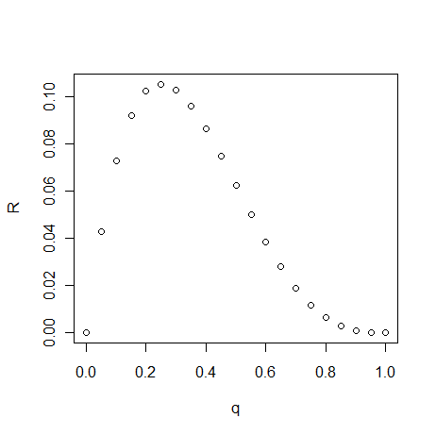
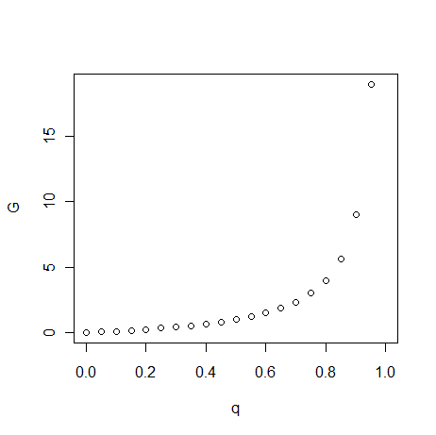
Is there an optimal aging (optimal life span)?
Plasticity of gene/protein network configuration provides the source of variation for cells to live in various environments.
Too much or too little plasticity for cells given an environmental variance?

Slide 68
SIR2 effect on G and R0: an effect on q? .
Kaeberlein et al 2006, PlosGenetics
Notes:
Verify by GFP, stochasticty in sir2D mutants?

Slide 69
Sch9 seems to influence the Gompertz coefficient.
Fabrizio et al 2004, JBC

Slide 70
TOR1 seems to influence the initial mortality rate.
Kaeberlein et al, 2005 Science

Slide 71
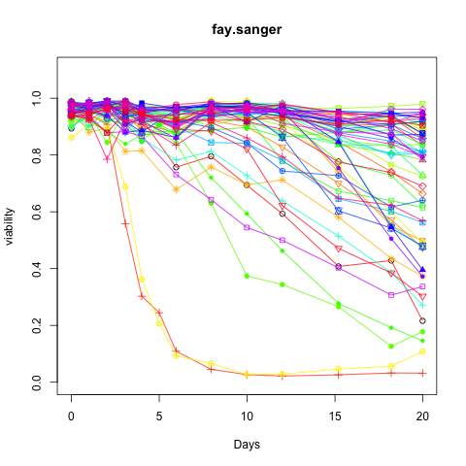
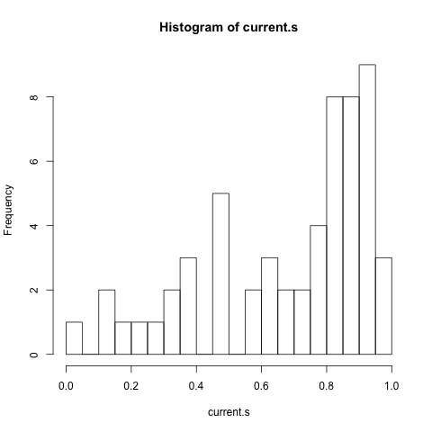
Survey of CLS in yeast strains (in progress)

Slide 72
Ethanol effect and radicicol effect variation in BY-RM11 segregants?

Slide 73
Other network modeling approaches of aging
Cells can be viewed as dynamic complex systems, which poses many attractor states. Homeostasis of different cell stages, such as G0 phase and other mitotic phases, can be viewed as attractor states.
KAUFFMAN, S., 1993 The Origins of Order: Self-organization and Selection in Evolution.
Death can be viewed as an absorbing state in the sense that cells can transition from other states into, but not from, the state of aging.
Environmental factors and genes can expedite or delay the transition from the homeostasis state to the aging state.
From the modeling perspective, failure to pass through cell cycle can be used as a criterion that cells have died during replicative aging, and failure to re-initiate cell cycle can be used as a criterion that cells have died during chronological aging.
Notes:
Chaos systems is deterministic.

Slide 74
Other models of aging based on networks
Kiss et al 2009, BioEssays, a gene (?) network model of aging based on game theory
Forever-young gene (?) network, globally cooperative, locally competitive
Always-old gene network, locally cooperative,
Lindner & Demarez 09, BBC, protein aggregates and aging
Severin et al, 08 BBA, Natural causes of programmed death of yeast S. cerevisiae.
Kowald & Kirkwood, 1994 JTB, a network of maintenance processes that integrates with free radical model and error propagations.
… …
Notes:
Severin et al, 08 BBA, Natural causes of programmed death of yeast S. cerevisiae.

Slide 75
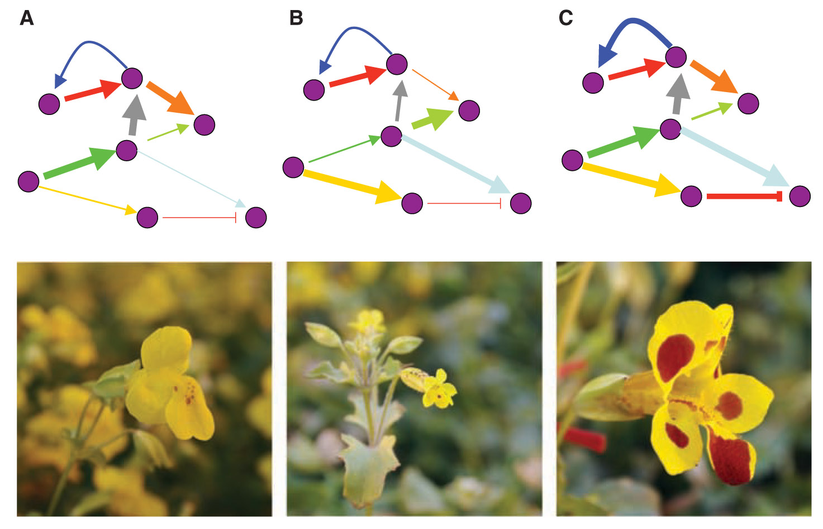
Systems biology meets natural variation: Variation is a key to infer interactions
Benfrey & Mitchell-Olds, Science, 2008, From genotype to phenotype: Systems biology meets natural variation.
Notes:
Fig. 1. Ways in which a hypothetical network could control flower form and color among Mimulus
species. The widespread species M. guttatus (A) has large, yellow flowers. In contrast, the flowers of
M. laciniatus (B) are typically 75% smaller than those of M. guttatus. Other species show elevated
expression of red anthocyanin pigments (C), as in this hybrid between subspecies of M. luteus. Changes at
various points in the network (represented by differing widths of the connections [arrows] between
network nodes [circles]) could be responsible for this natural variation. [Photos by J. Modliszewski]

Slide 76
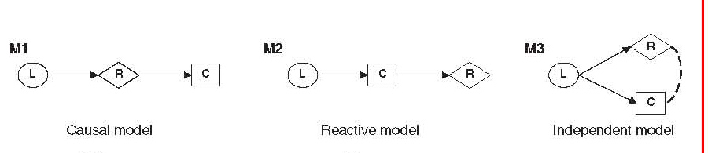
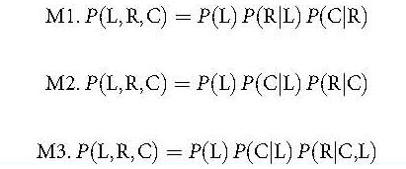
Identifying causal interactions by model comparisons
Schdat et al, 2005 Nature Genetics
Notes:
AIC

Slide 77
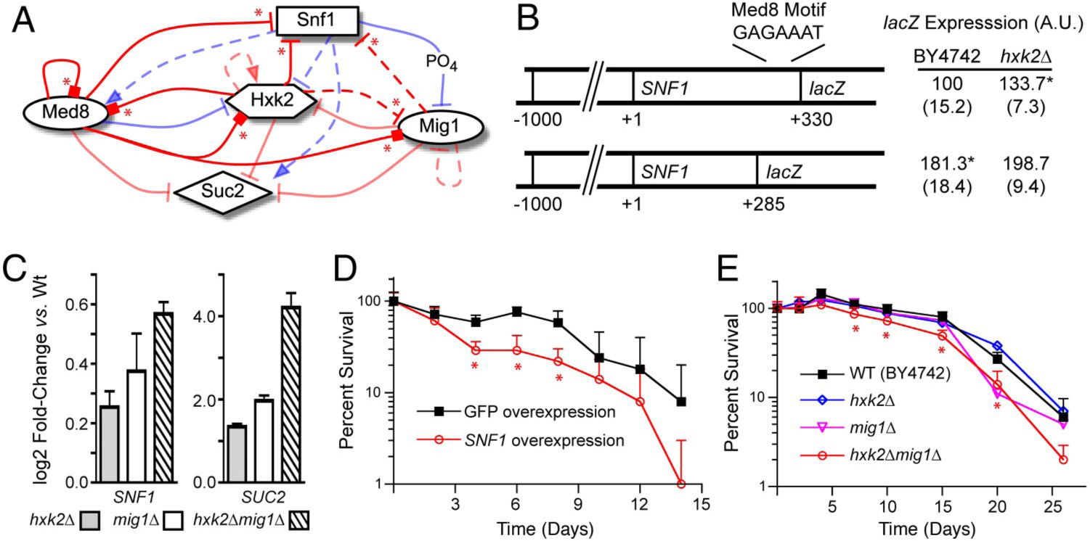
Regulatory networks can be inferred from perturbation.
Lorenz, Cantor, & Collins 2009, PNAS, A network biology approach to aging in yeast.
Notes:
Fig. 4. Characterization of SNF1 transcriptional regulation and its effects on chronological lifespan. (A) Schematic of hypothesis tested in subsequent experiments that SNF1 gene expression is repressed by Hxk2, Med8, and Mig1 in 2% glucose (red arrows), in a manner analogous to the previously detailed regulation of SUC2 (asterisks denote new interactions predicted by the network model and confirmed experimentally in this study). Definitions of other symbols are the same as in Fig 1. (B)AputativeMed8binding motif in the coding sequence of SNF1 represses expression of SNF1 promoter-lacZ fusions with Hxk2. Plasmids containing SNF1 promoters and variable lengths of the SNF1 coding region to include (SNF1330) or exclude (SNF1285), a sequence similar to the Med8 consensus motif fused in-frame to the lacZ reporter gene were transformed into hxk2 and isogenic wild-type strain BY4742. ß-gal activity was measured in SC media2%glucose. Values are normalized such that ß-gal activity in SNF1330/BY4742100, to compare data across multiple experiments. Asterisks indicate P 0.05 relative to SNF1 330/BY4742. (C) Double deletion of HXK2 and MIG1 derepresses SNF1 expression synergistically. SNF1 and SUC2 (positive control) mRNAexpression in hxk2, mig1, and hxk2mig1deletion mutants relative to isogenic wild-type strain BY4742 was determined by qRT-PCR for culturesgrown in SC media 2% glucose. Error bars denote propagated standard error. (D and E) Effects of SNF1 expression on chronological longevity. Percent survival of poststationary phase cultures was determined from CFUs of batch cultures grown in SC media 2% glucose. SNF1 and GFP overexpression strains (D) were the same as those used in perturbation experiments, constructed in the W303-derived strain BMA64–1A. Error bars denote standard deviation; data points with
asterisks (*) signify statistically significant differences (P 0.05) in CFUs relative to control at the same time point.

Slide 78
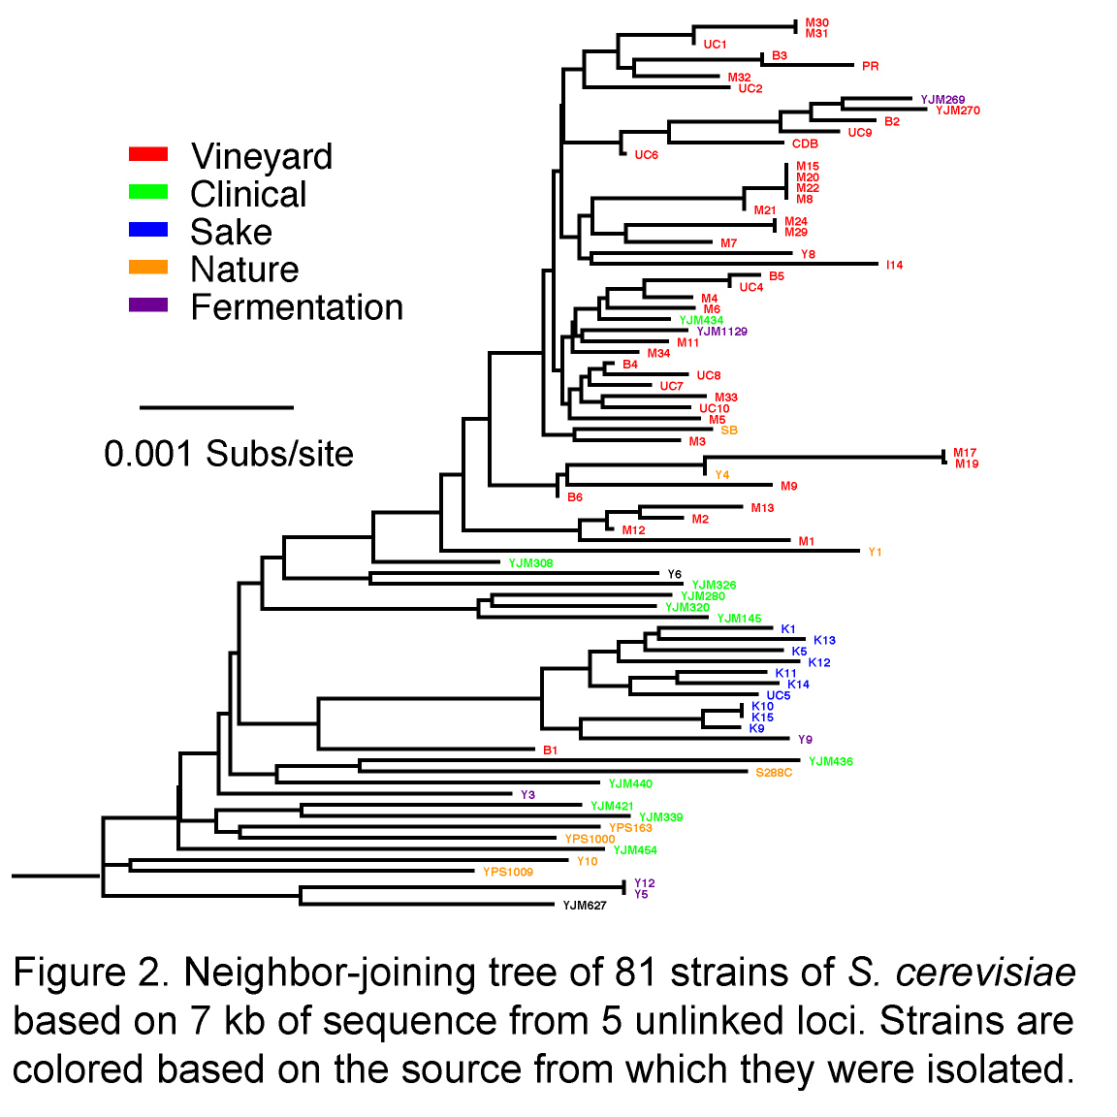
S. cerevisiae populations
Fay et al, 2005 Plos Genetics

Slide 79
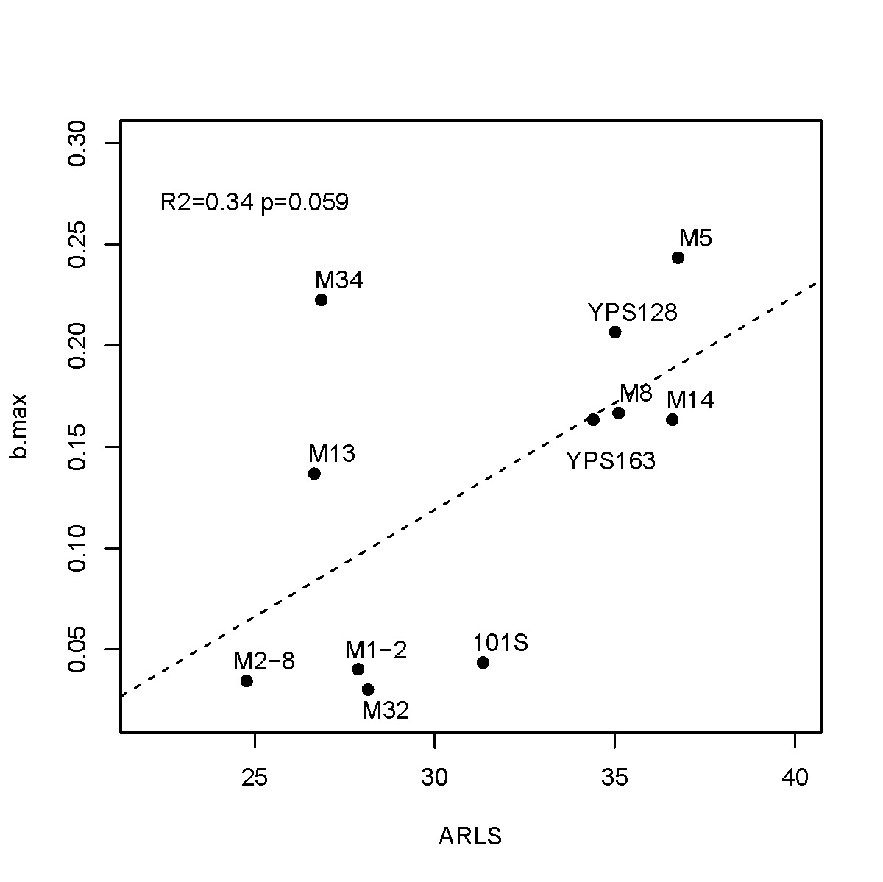
Tolerance to genomic instability accounts for 30-50% replicative life span variation among strains.
Tg/Tc
Trmax/Tmmx
bmax
Work in progress:
Genome-wide association study of sequenced strains
Qin et al, 2008

Slide 80
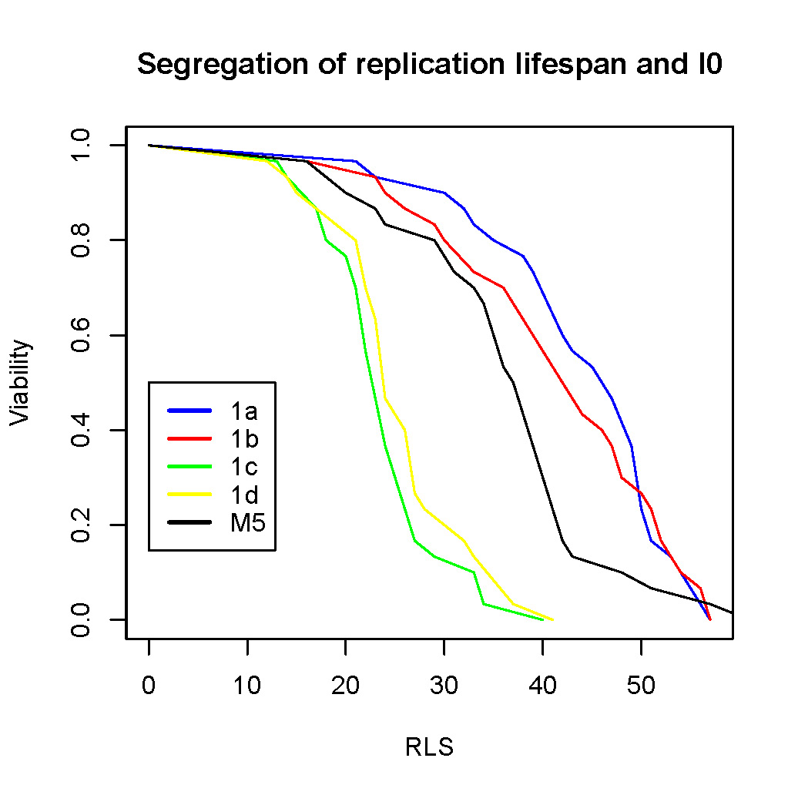
Segregation of replicative lifespans after meiosis
I0 G RLS
1a 0.00014 0.14 44.1
1b 0.00065 0.11 41.6
1c 0.0032 0.14 23.8
1d 0.0027 0.14 25.6
M5 0.0020 0.09 38.6
Qin et al, unpublished
Notes:
To investigative genetic mechanism of natural lifespan regulation, we performed parallel rls assay on four segregants from a single spore.
M5 is the parental strain. 1a, 1b, 1c, 1d are the four segregants of a meiotic event. What we observed here is a 2:2 segregation, what suggests that a single gene effect, and it is partially recessive.
On the right side are the estimated I0, G and average lifespan. There is 5-10 fold change of the I0 component.

Slide 81
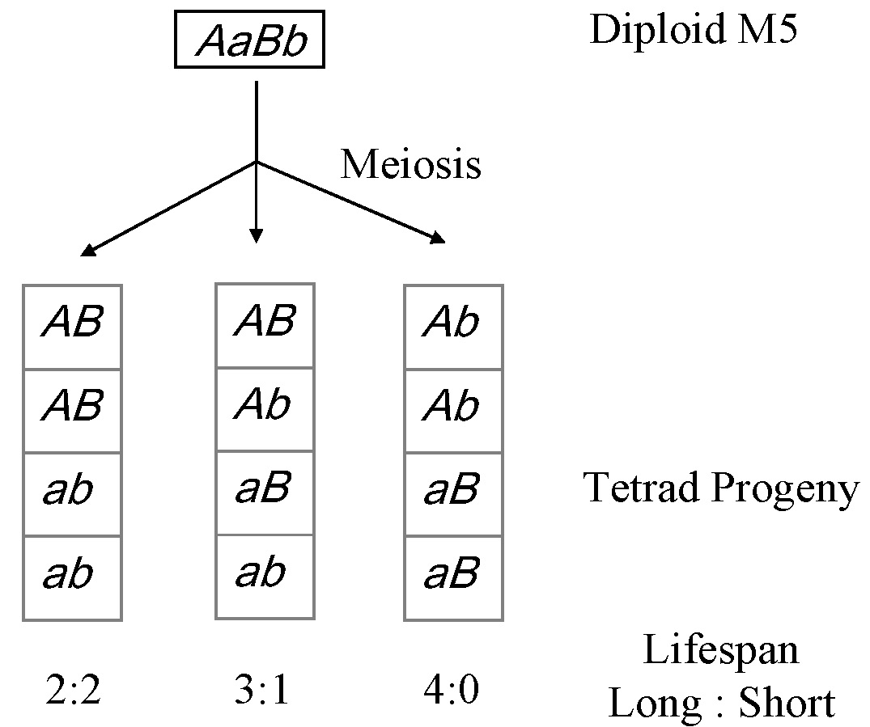
The working model
7 1 0
PD T NPD

Slide 82
Differential expression between long- and short-lived segregants.
Gene ID | Gene Name | long1 | long2 | short1 | short2 | long pool | short pool
YCR021C | HSP30 | 1.00 | 1.07 | 1.19 | 1.86 | 1.00 | 1.38
YDL039C | PRM7 | 1.03 | 1.00 | 1.21 | 1.43 | 1.00 | 1.46
YDL042C | SIR2 | 1.89 | 1.31 | 1.11 | 1.00 | 1.39 | 1.00
YEL074W | Unknown | 1.02 | 1.00 | 1.19 | 1.30 | 1.00 | 1.27
YJL143W | TIM17 | 1.09 | 1.10 | 1.01 | 1.00 | 1.14 | 1.00
YLR194C | Unknown | 1.00 | 1.08 | 1.27 | 1.43 | 1.00 | 1.30
YLR214W | FRE1 | 1.17 | 1.22 | 1.00 | 1.00 | 1.19 | 1.00
YLR408C | Unknown | 1.25 | 1.22 | 1.11 | 1.00 | 1.11 | 1.00
YLR411W | CTR3 | 1.18 | 1.26 | 1.00 | 1.02 | 1.25 | 1.00
YMR215W | GAS3 | 1.00 | 1.08 | 1.15 | 1.27 | 1.00 | 1.16
YNR018W | Unknown | 1.00 | 1.01 | 1.17 | 1.12 | 1.00 | 1.17
YNR020C | Unknown | 1.09 | 1.10 | 1.02 | 1.00 | 1.11 | 1.00
YOL016C | CMK2 | 1.00 | 1.09 | 1.21 | 1.52 | 1.00 | 1.26
YOR084W | Unknown | 1.00 | 1.07 | 1.18 | 1.19 | 1.00 | 1.21
YPL014W | Unknown | 1.00 | 1.06 | 1.18 | 1.55 | 1.00 | 1.33

Slide 83
Highthroughput genotyping to identify QTL (work in progress)
Genotypes with long life span
Genotypes with short life span
Pooled genomic DNA
Pooled genomic DNA
Genotyping by tiling array, Gresham, et al, 2006, Science
QTL by tiling arrays, Brauer, et al, 2006 Genetics
QTL by MassARRAY Typer, Gerke, et al, 2008 Science
Review by Gresham, et al, 2008, Nature Genetics
Notes:
Group F1 cells by their life span. Long lifespan allele should always be associate with long lifespan. Short lifespan allele should always be associated with short lifespan phenotype. We can pool the group of DNA and use tiling array to genotype them.
Genotyping by 454 sequencing, Gerke, et al, 2008 Science

Slide 84
The plan for yeast
Divergence and polymorphism association test among unlinked interacting genes/proteins
Subpopulation structure inferred by house-keeping genes using the program STRUCTURE
Pilot study of a list of 300 genetic capacitors (Levy and Siegal, 2008, Plos Biology) and 8 heat shock protein families
It is expected that both divergence and polymorphism will increase in the target genes of capacitors (Supported by empirical evidences of Hsp90 from the Linquist lab, and the Rutherford lab)
It is also expected that expression variance and other phenotypic measures will increase in target genes of capacitors.
Minor alleles, major alleles, intermediate alleles;
Cross/Engineer strains to generate unobserved allele combinations
Fitness can be inferred by competitive growth, monitored by genetics markers (platting, PCR, array hybridization, etc)
How to remove indirect associations?
Use S. paradoxus as outgroup to look for alleles with negative epistatic effect
Compare allele frequency patterns with the fitness landscape
Pilot study in genes with temperature-sensitive mutants and “epistatic” interactions (synthetic lethal, synthetic-sick, over-expression, etc)
Informatics, molecular evolution, followed by association analysis in the network
Interacting domains?
See Kim et al, 2006, 2007
Expand to whole-genome inference
LRT or AIC based comparison of different two-locus models.
The null model is non-interactive. Alternative models: interaction among loci
Notes:
Yeast has two copies of HSP90: HSP82, HSC82
Hsp82p and Hsc82p are required for the activation of many key cellular regulatory and signaling proteins, like kinases and transcription factors, such as Swe1p, Gcn2p, and Hap1p (reviewed in 14, 15, and 16).
14)Burnie JP, et al. (2006) Fungal heat-shock proteins in human disease. FEMS Microbiol Rev 30(1):53-88
15)Picard D (2002) Heat-shock protein 90, a chaperone for folding and regulation. Cell Mol Life Sci 59(10):1640-8
16)Prodromou C and Pearl LH (2003) Structure and functional relationships of Hsp90. Curr Cancer Drug Targets 3(5):301-23
--------------
Liquist lab web site: Hsp90 potentiates the evolution of drug resistance by allowing new mutations to have immediate and beneficial consequences. By chaperoning “calcineurin”, Hsp90 allows it to function in stress-response pathways that prevent the celluar stress from the mutations from becoming lethal.

Slide 85
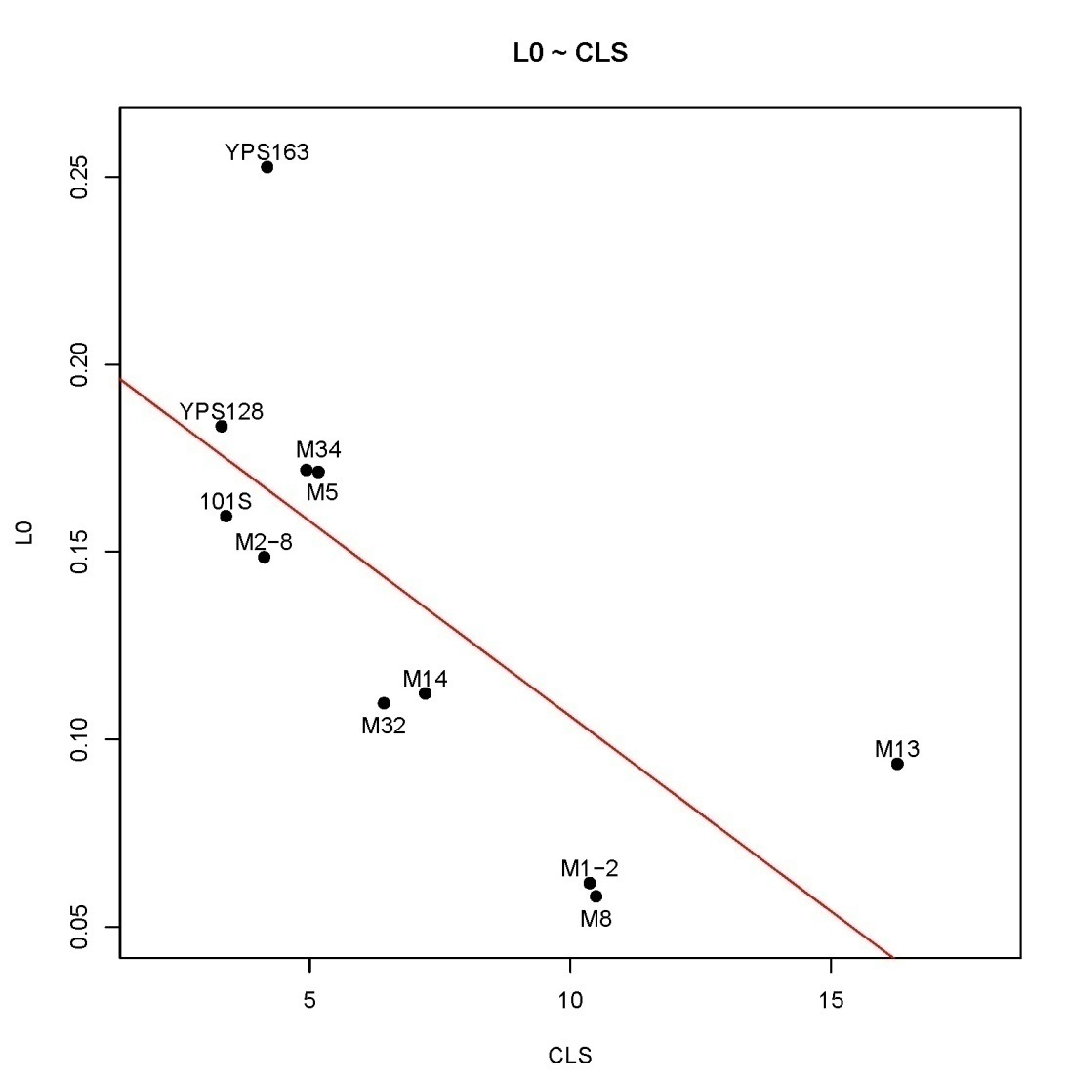
Initial mitotic asymmetry is negatively associated with chronological life span among strains.
Work in progress:
Genome-wide association study of the sequenced strains
Phenotype both the sequenced strains and the deletion collection.
Similar to Andersen and Gottschling 2008.
R²=0.53
P=0.01
Qin et al, 2008

Slide 86
The key steps:
Compare the observed genotypic distributions in different yeast populations and to the fitness landscape based on models of epistasis.
For example, difference between clinical isolates and other strains can provide clues on the pathogenic ability of the clinical isolates.
Fitness landscape can pinpoint the adaptive allelic interactions.

Slide 87
How do we define aging at the molecular level?
This is related to the overall fitness of the cells.

Slide 88

Saccharomyces species

Slide 89
Overview of candidate projects
Natural variation in life span and genomic instability in S. cerevisiae
QTL study
Pleiotropic effects of longevity genes through gene network and pathways
Preliminary data and strains are available.
Try NSF career award, Glen Foundation, AFAR, NIA, etc
A collaborative proposal with PIs at the UC
Epistasis and gene/protein networks
Phenotypic capacitors and network buffering
Yeast gene/protein networks
Human gene/protein networks

Slide 90


Natural isolates have longer replicative life span but shorter chronological life span than lab strains do.
Frequency
Replicative lifespan (cell divisions)
Chronological lifespan (days)
Qin and Lu, 06
Exp Gerontology
Qin and Lu, 2006
Notes:
Use the number instead of density.

Slide 91
Yeast as a model of age-dependent increase of genomic instability
Cancer
LOH
McMurrary & Gottschling, 04
Notes:
Gottschling’s review

Slide 92
Available genomes of S. cerevisiae.
Currently, eight strains have been sequenced
S288c, W303, SK1, RM11, M22, YPS163, YPS128, YJM789
Many yeast strains have been sequenced or soon-to-be sequenced.
100 strains to be sequenced by Wustl (Fay and Kruglyak, 2006)
14 strains by Sanger Institute
Preliminary genome-wide association scan
We will phenotype the strains with sequenced genomes
Notes:
S288c, W303, SK1, RM11, M22, and YPS163 stains
NCBI trace archives

Slide 93
Traits for GWA analysis using the sequenced strains
Initial mitotic asymmetry
Accounts for 50% variance in CLS
Resistance to paraquat
Tolerance to genomic instability
Tg/Tc and bmax
Accounts for 30-50% variance in RLS
RLS and CLS
Strains and segregants

Slide 94

Epistasis: the classic view on gene interactions
Moore, Nature, 2005, A global view of epistasis
Notes:
Figure 1 Genetical, biological and statistical epistasis. Genetical epistasis can be thought of as the interaction among DNA sequence variations (vertical bars) that give rise to a particular phenotype in an individual. Genetic information affects phenotype through a hierarchy of proteins (circle, square, triangle) that are involved in biological processes ranging from transcription to physiological homeostasis. The physical interactions (dashed lines) among proteins and other biomolecules and their impact on phenotype (star) constitute biological epistasis. There is a very close relationship between genetical and biological epistasis, with each occurring at the level of the individual. Differences in genetical and biological epistasis among individuals in a population give rise to statistical epistasis. It is entirely possible for genetical and biological epistasis to occur in the absence of statistical epistasis. This can happen when the DNA sequence variations and biomolecules are the same for every individual sampled from a population. Thus, genetic and biological variation is crucial for the statistical detection of epistasis. But does evidence of statistical epistasis necessarily imply genetical or biological epistasis?

Slide 95

Gene/protein networks: the highthroughput results
Protein networks
Uetz, et al, 2000, Nature
Ito, et al, 2001, PNAS
Gavin, et al, 2006, Nature
Krogan, et al, 2006, Nature
…
Genetic interactions
Tong, et al, 2001, Science
Schuldiner, et al, 2005, Cell
Pan, et al, 2006, Cell
Collins, et al, 2007, Nature
Jasnos, et al, 2007 Nature
Onge, et al, 2007, Nature Genetics
…

Slide 96


Network can bridge different fields of biology: Interaction network may integrate our knowledge of population genetics and biophysics
Kim, et al, 2006, Science
Kim, et al, 2007, PNAS

Slide 97

Hsp90 can buffer variation in its client proteins
Rutherfor, 2007 Critical Rev in Biochem & Mol Biol

Slide 98


Networks can buffer phenotypic variations
Bergman and Siegal, 2003 Nature
Levy and Siegal, 2008 Plos Biology

Slide 99
Our focus
Integration of genetics and network biology
Notes:
Ecological niche and life style
Implication on anthrax

Slide 100
The two-locus two-allele model for Hsp90
Target locus (unlinked)
Hsp90
Notes:
Karlin and McGregor, 1972,PNAS, evolutionary development of modifier genes
Adopted from Gavrilets, 2004, Fitness landscape and the origin of species

Slide 101
The two-locus two-allele model for Hsp90
HW equilibrium
Inbreeding: U-shape
Deleterious models: additive, multiplicative, and others?
Target locus (unlinked)
Hsp90
How about frequency table?
Notes:
Karlin and McGregor, 1972,PNAS, evolutionary development of modifier genes
Adopted from Gavrilets, 2004, Fitness landscape and the origin of species

Slide 102

Phenotypic capacitance increase polymorphism in target genes.
Rouzic & Carlborg, 2007

Slide 103
The plan
First in yeast:
Gene/protein network,
Fitness assay
Experimental verification
Data for divergence and polymorphism data (genotypes)
Resource for functional genomics
Then expand to human
Gene/protein network
Polymorphism data (genotypes)
Candidate gene approach based yeast orthologs
Disease or trait association
Other model organisms
Mouse, worm and fruit fly

Slide 104
An interesting scenario (The holy-grail)
Interacting loci with synthetic-sick (synthetic-lethal) pairs of natural alleles Implication on human disease A truncated nuclear pore protein in a natural isolate of S. cerevisiae (Qin & Goldfarb, unpublished results).

Slide 105


Some other projects
Latent Dirichlet Allocation based expression meta analysis
Blei et al 2003

Slide 106
Gene interaction from different perspectives
Moore, Nature, 2005, A global view of epistasis
Notes:
Figure 1 Genetical, biological and statistical epistasis. Genetical epistasis can be thought of as the interaction among DNA sequence variations (vertical bars) that give rise to a particular phenotype in an individual. Genetic information affects phenotype through a hierarchy of proteins (circle, square, triangle) that are involved in biological processes ranging from transcription to physiological homeostasis. The physical interactions (dashed lines) among proteins and other biomolecules and their impact on phenotype (star) constitute biological epistasis. There is a very close relationship between genetical and biological epistasis, with each occurring at the level of the individual. Differences in genetical and biological epistasis among individuals in a population give rise to statistical epistasis. It is entirely possible for genetical and biological epistasis to occur in the absence of statistical epistasis. This can happen when the DNA sequence variations and biomolecules are the same for every individual sampled from a population. Thus, genetic and biological variation is crucial for the statistical detection of epistasis. But does evidence of statistical epistasis necessarily imply genetical or biological epistasis?

Slide 107

Natural variation and causal interactions
Rockman, 2008, Nature, Reverse engineering the genotype-phenotype map with natural genetic variation.

Slide 108

Genotypic and phenotypic spaces, a current view
T1: systems biology, functional genomics, highthroughput phenotyping, etc
T2: ecology, archeology, anthropology, history, etc
T3: highthroughput genotyping, statistical genetics, reverse engineering, etc
T4: Genetics
T4
T1
T3
T2
Notes:
It is really just my view.
Richard Lewontin, The genetic basis of evolutionary, change, 1974, Columbia University Press.

Slide 109
The goal
To understand phenotypic variation based on sequence variation through gene/protein networks. Specifically, we focus on network emergent properties, such as aging.

Slide 110
Genotypic and phenotypic spaces, the classic view
T4
T1: Epigenetic laws
T2: Mating, migration, natural selection
T3: Inference of genotypes
T4: Genetics
T1
T3
T2
Lewontin, RC, 1974
Notes:
Richard Lewontin, The genetic basis of evolutionary, change, 1974, Columbia University Press.

Slide 111

Systems biology: A network perspective on biological heterogeneity
Gene/protein interactions
Environments
Phenotypic heterogeneity

Slide 112





The Search for General Theories and Mechanistic Models

Slide 113











Modern biology is rich in data but poor in mechanistic models.

Slide 114
Implications of the network aging model
Theoretic perspectives
Based on yeast gene/protein networks
Connection between aging and genetic capacitors
Mutation and selection on gene interaction, fitness and aging.
Lethality due to multiple interactions
Power-law networks versus random networks
Heterogeneous rates of exponential decays
Empirical perspectives
G as a proxy of robustness (a phenotypic measure)
Provides a new perspective to interpret experimental data

